Slide 1
Communicating Architecture in a Remote Work World
Better Boxes and Lines
Brian Gardner - Senior Staff Software Engineer
nuvalence.io
Notes:
Thank you for coming to my talk on software architecture.

Slide 2

Notes:
Thank you to our sponsors for making the conference possible.

Slide 3










Slide 4
Nuvalence is a next-generation agency using a product-driven
approach to help enterprises define and build digital platforms
and products.
Notes:
We do consulting work with large enterprises, and in the public sector.
Often, we need to design new systems, and integrate with existing systems
Often involves meeting with many SMEs from the client, and varying levels of documentation to learn legacy system
Often need to get buy in from teams and architects on new vision forward

Slide 5
Outline
How is Architecture Communicated?
A Better Model
Tools and Scenarios
What Works and What Doesn’t
Opinionated Decomposition using C4 Model
Pick the right tool for the job

Slide 6
How Is Architecture Typically Communicated?
Notes:
Most of you probably are in one of 3 buckets:
You regularly work with external clients in a consulting manner
You’ve started new job fairly recently
You’ve been at your company for a while, but you regularly hand off systems to operations team or to off-shore support
How do we transfer hard won knowledge to others?
Meetings
Verbal explanations, depending on audience taking good notes
Synchronous
Long form documentation
Is it accurate still? Does anyone actually read it?
Diagrams

Slide 7


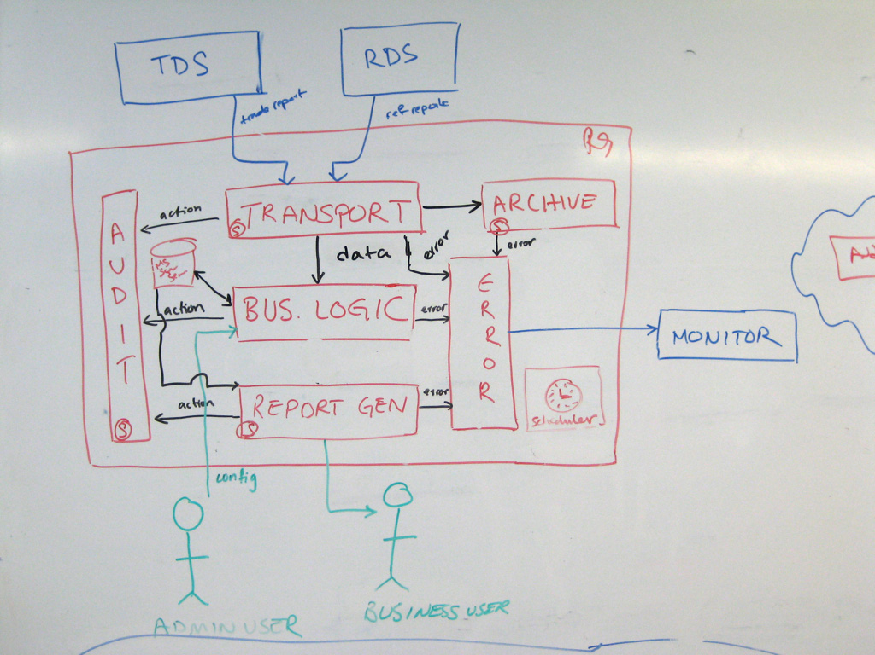
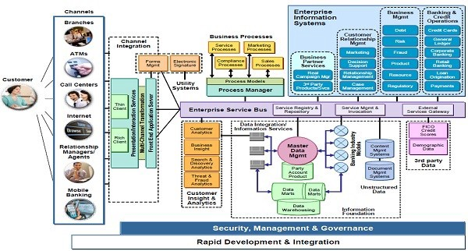
Notes:
Usually it looks like some combination of the above
In a pre-covid world, you might get pulled into a conference room and someone draws up how things work on a whiteboard
Now, you get to sit on a Zoom call for a few hours to have it explained
Maybe there’s some written documentation of questionable completeness and accuracy
Maybe there’s a diagram with WAY too many or way too few pieces of information
All of this costs time and money to consume and digest

Slide 8
Structural vs Sequential
Notes:
Regardless of the medium the information is conveyed, it probably breaks down into 2 distinct categories: Structural & Sequential

Slide 9
Structural Diagrams
Objective | Description
Answer “What” Questions | At a quick glance, we can easily see what databases are used, what third party services are required, and what the overall architecture looks like.
Identify Technology Choices | Icons can quickly identify technology stacks. By making this visual, it makes the mental map more useful, easier to understand, and prevents needing to dig through documentation to confirm.
Show System Dependencies | Drawing arrows between systems, and labeling the purpose of the connection saves time in identifying downstream impacts.

Slide 10
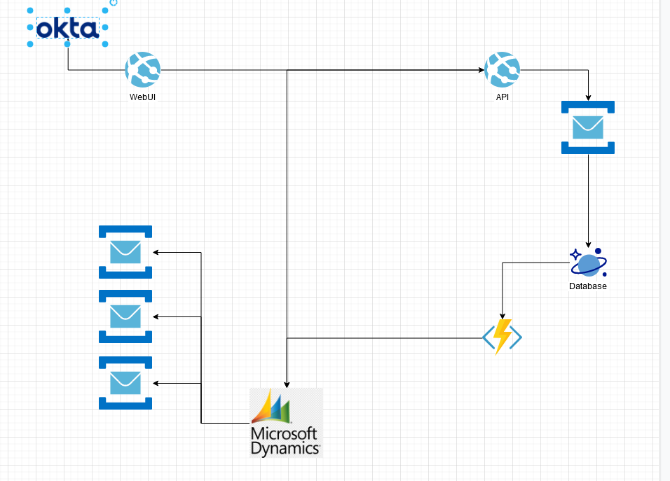
Example: Product Registration & Warranty
Notes:
In 2017, I joined a local company as a tech lead for Product Registration & Warranty management system
Recreated from memory, not the real thing
US Launch in 6 months, followed by multiple international launches in the following months
Each region had its own systems that needed to be integrated
Each market and product had different rules on how to handle service contracts
Each market also wanted to track warranties in their own systems.
Markets couldn’t know about each others warranties.
Many, many meetings about how to use this system
Pros
Visual aid helped teams in multiple countries understand the problem and our solution
Helped cross cultural / language barriers to understanding
Helped delineate global / local market responsibilities
Starts to illustrate technology choices made
Cons
Different audiences cared about different things
DIdn’t answer the question of how to use from local market perspective
Doesn’t answer who uses the system, or how
Doesn’t document why tech choices were made
Tech lead of small team building service to track registrations and warranties on durable goods across the globe.
Drew up this diagram

Slide 11
Sequential Diagrams
Objective | Description
Answer “When” Questions | By following a sequence, we can answer when events are published, when records are created, and see when new logic needs to execute
Answer “How” Questions | By understanding the flow of the system, we can answer how data moves from System A to System B, and the systems in between. This is much faster than tracing code paths in a distributed system.
Provide Granular Detail | Sequence diagrams that cover all possible use cases and paths are too big to be useful. So they are inherently best used for detailed documentation of a single use case. So it would be difficult to derive a broad overview of a system and its architecture from these diagrams

Slide 12
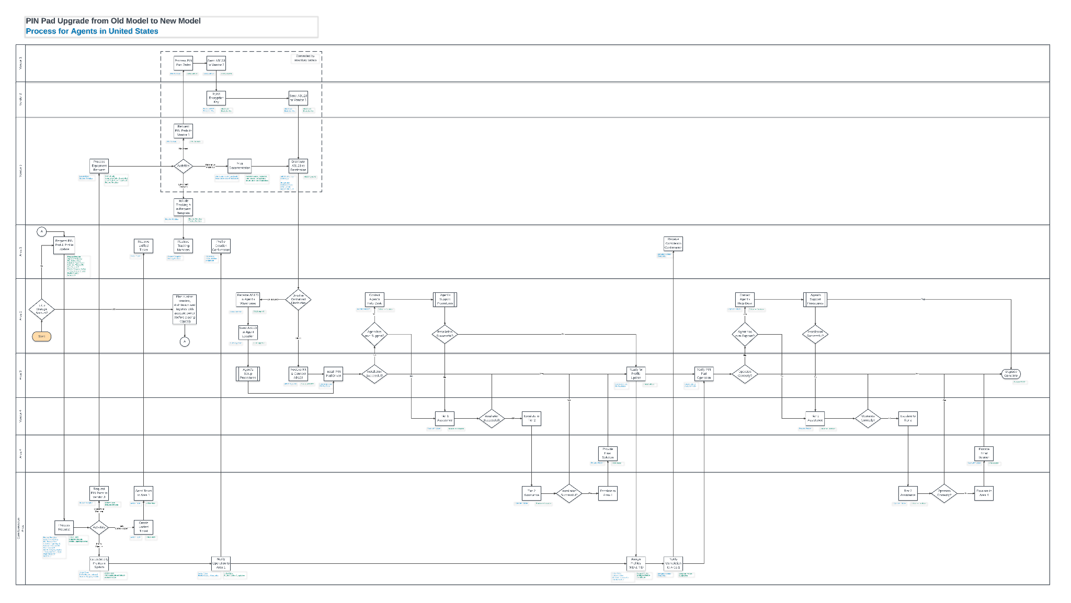
Notes:
After that company, I went to do some contract work at a smaller financial institution.
Event based microservices environment. Hybrid cloud.
Asked to document the flow of events in the system.
Chose to do a swimlane diagram in Visio.
Many of these event flows had been in place for 6+ months already
Write once, never updated again afterwards. Willing to bet it's still sitting in its original state on a shared drive somewhere.
After about 2 years, that engagement ended. I joined another local company focused on fundraising.
A few months after I started, this happened. NEXT

Slide 13

Notes:
Company going through on-prem to cloud migration, new mobile app, rearchitecting for new app. Shortly after we launched that, we had another round of features to deliver on short time window with a hard deadline

Slide 14
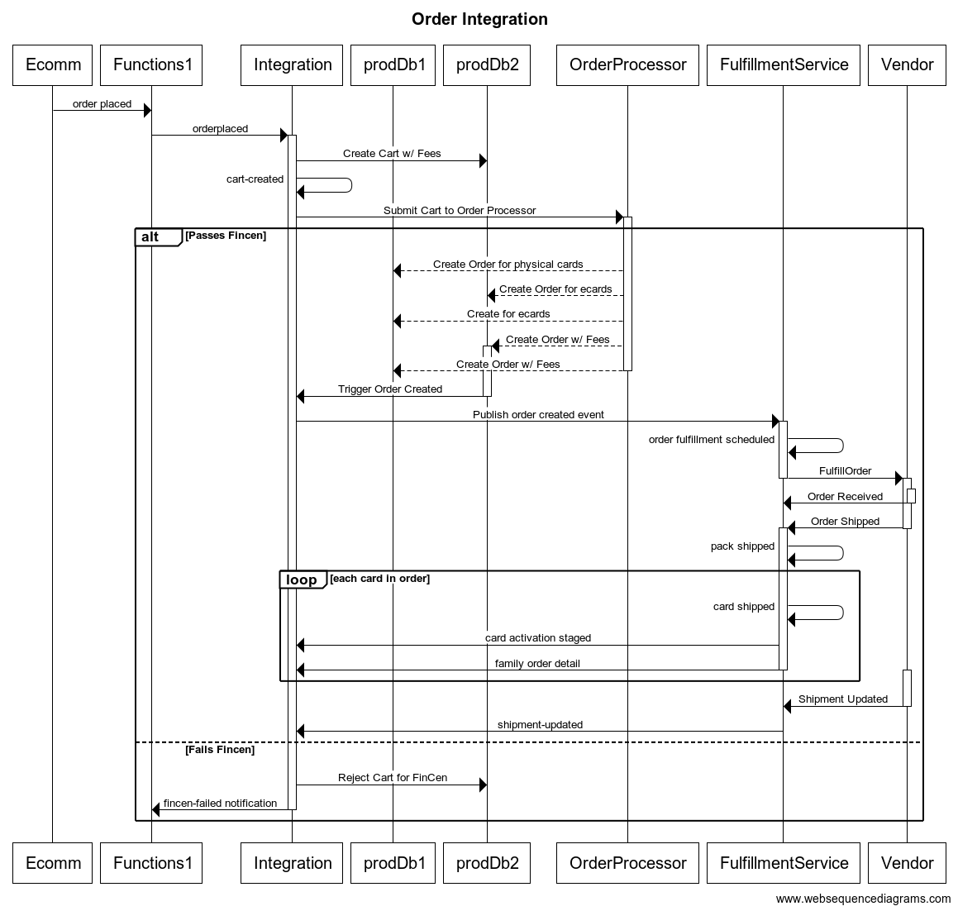
Notes:
Drew up something that look like that
Not exactly that, but close.
Pros
We identified multiple problems up front
Easier to see where work can be divided
Dividing work allowed it to happen in parallel, and helped teams communicate about handoffs.
Cons
Is this architecture?
Rework around the data structures being handed off between systems
Loss of continuity from structure to sequence
Outcomes
Launched on time, successfully.
Holidays, scaled beyond what 3rd party could handle.

Slide 15
Problems with Architecture Documentation
Problem | Description
Audience Mismatch | Most diagrams try to be useful to everyone, so end up being useful to no one. There’s either too much detail that it overwhelms non-technical people, or too little to provide value for technical people.
Tooling is Bad or Expensive | Does anyone really like to rearrange lines everytime a new box gets drawn? Miro is very nice, but do we really need to pay for another another web based tool disconnected from our code? And all of these start with a blank slate, and no opinion on where to start.
Documentation is Stale | The more distance between the code and the documentation, the less likely it is to be updated. Which would you rather update? Markdown or Confluence?
Process keeps people out of the loop | It’s hard to give suggestions on diagrams after it’s created. Comments and suggestions in a document are easier to create, but can get lost in the flood of notification emails. And you have to know the page exists in the first place.

Slide 16
How should we convey information about software and architecture in a remote world?
Business Leadership
Project Management
Developers on your team
Developers on other teams
Notes:
Both Structural diagrams and Sequential diagrams help, but neither seems to fit the bill very well.
Remote isn’t just the new world of work from home
Many companies are global, and we need to work across time zones and continents

Slide 17


A Lucky Find
Kamil Grzybek
Simon Brown
https://github.com/kgrzybek/modular-monolith-with-ddd/
Creator of C4 & Structurizr
Notes:
Stumbled into the repository by Kamil while doing some research into DDD and Event Sourcing examples.
Found his readme has a number of diagrams, including C4 model.

Slide 18
C4 Model for Software Architecture

Slide 19
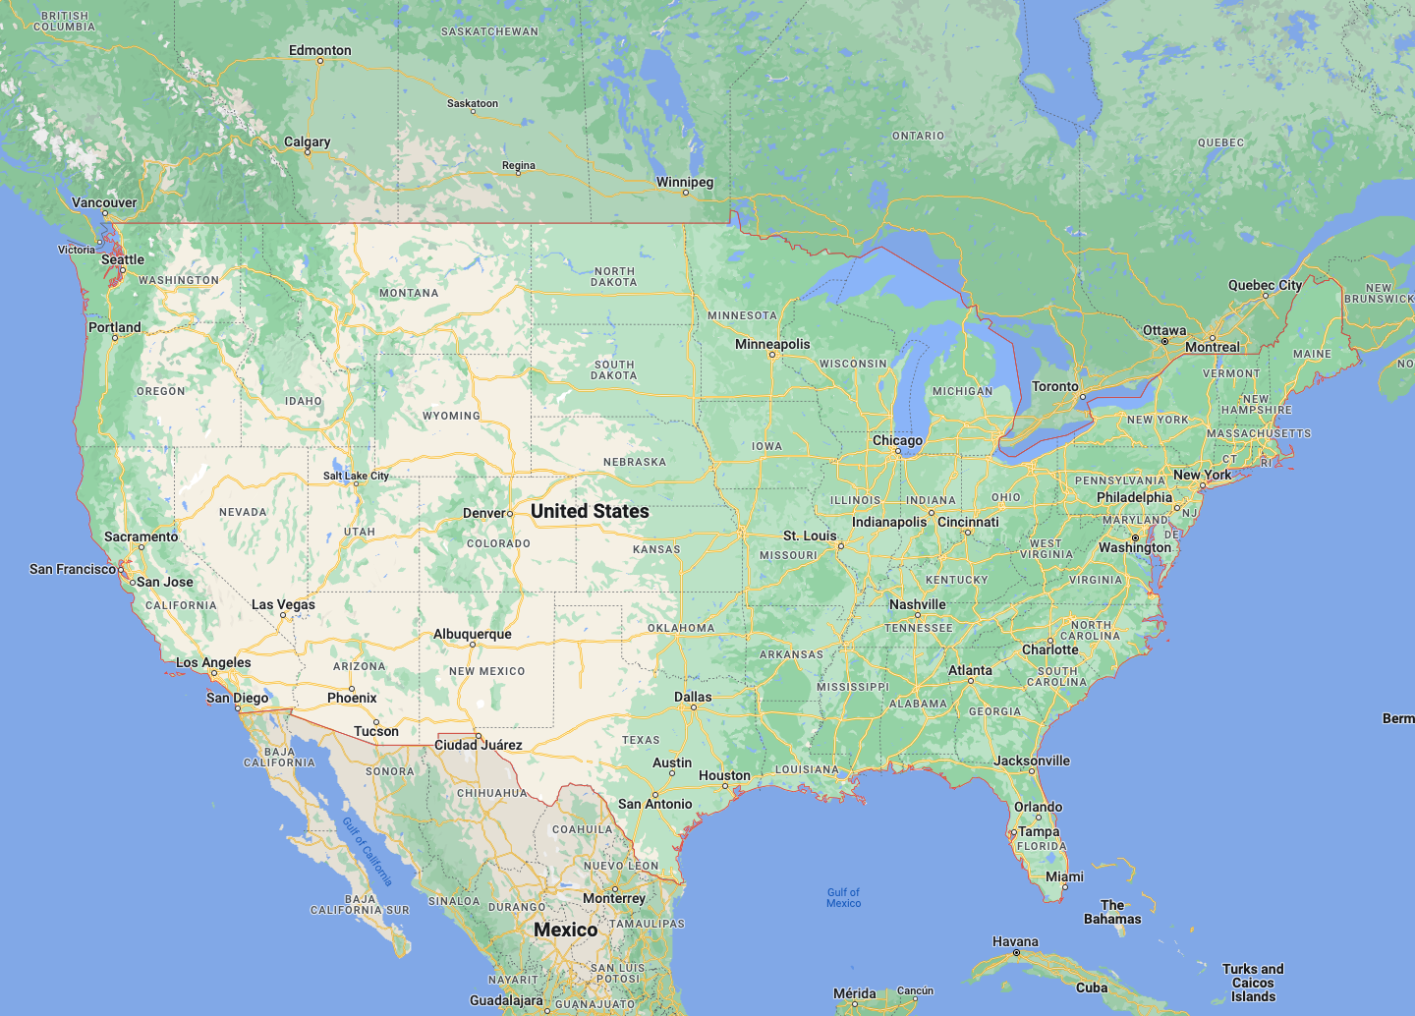
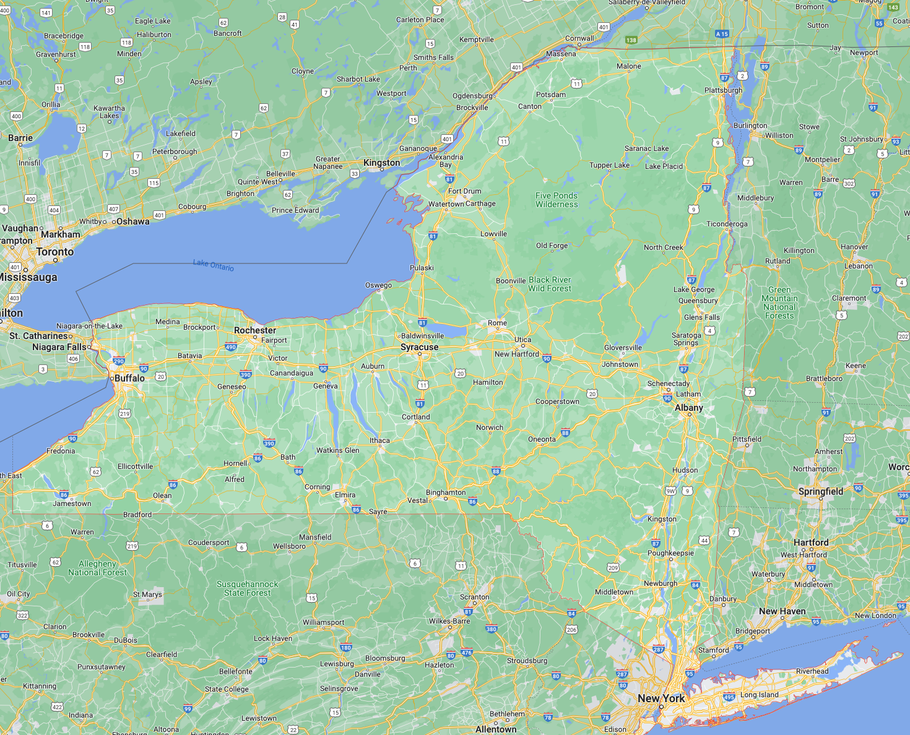
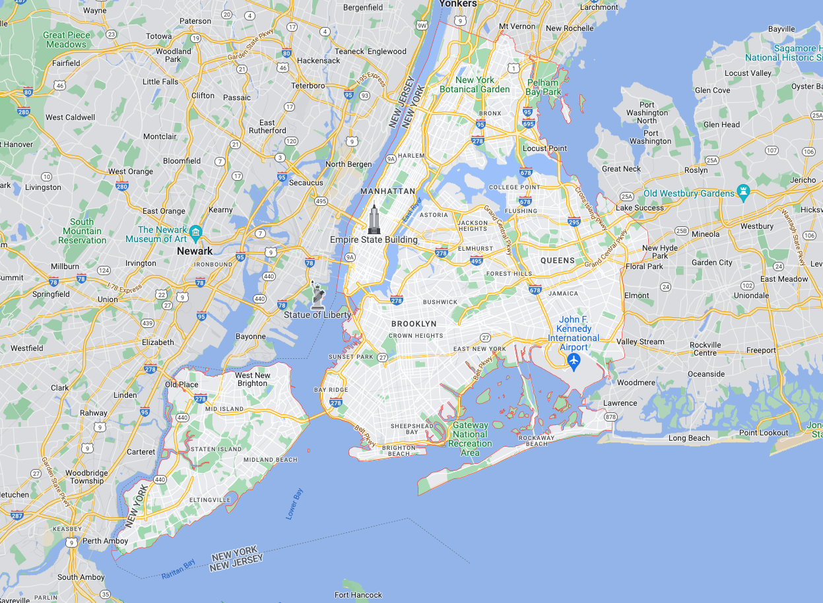
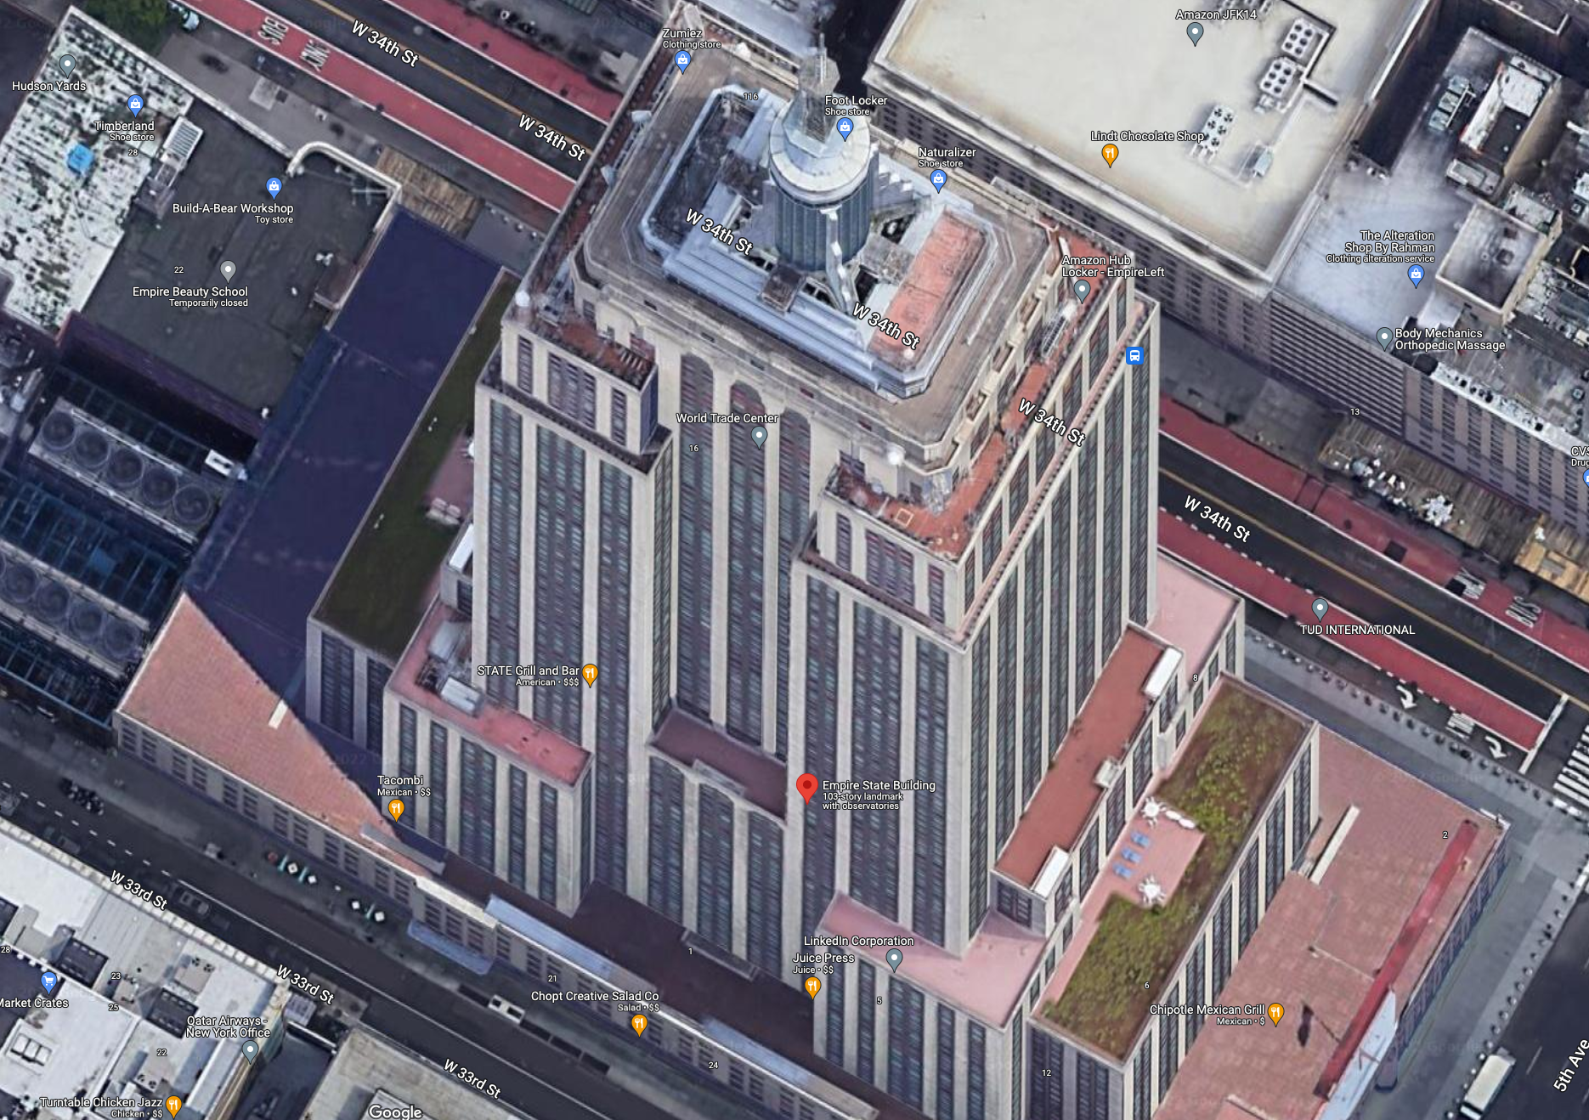
C4 Model Overview- c4model.com (Simon Brown)
Level 1- Context
Level 2- Containers
Level 3 - Components
Level 4 - Code
Where does this fit?
Not Docker
Broad overview of where this new system fits in the grand scheme of things
Individually deployable, high level logical parts that make up the system
Groups of functionality
Class Diagrams
Namespace, package, or other modular piece within a codebase
Class level diagrams
Notes:
Common framework and language to start diagramming an architecture. Think pinch and zoom on maps

Slide 20
Purpose of C4
Objective | Description
Communication | A picture is worth a thousand words. With a series of modular, decomposed diagrams, you can tailor your communication easily based on the scenario (onboarding of new developers, executive pitch, architectural deep dives). And images are easier to transmit and understand in remote environments compared to long verbal explanations.
Target Different Audiences | Different audiences required different levels of detail. The needs of a developer vs the needs of an executive in understanding a software system are quite varied, but are definitely connected.
Eliminate Confusion | Large diagrams trying to encapsulate too many details can be very difficult or confusing for many people. It can be information overload for people new to the system. It can be too much noise for more experienced people who may want to make a small change, or answer a question.
Opinionated Framework | Opinionated frameworks help accelerate progress in many areas of development. MVC and REST are examples of this. While these are not the only ways to build software, they help consistency, and give developers a starting point to solve a problem. Similarly, having an opinionated framework for how to decompose a system helps when starting with a blank slate, and helps others contribute more quickly and consistently

Slide 21
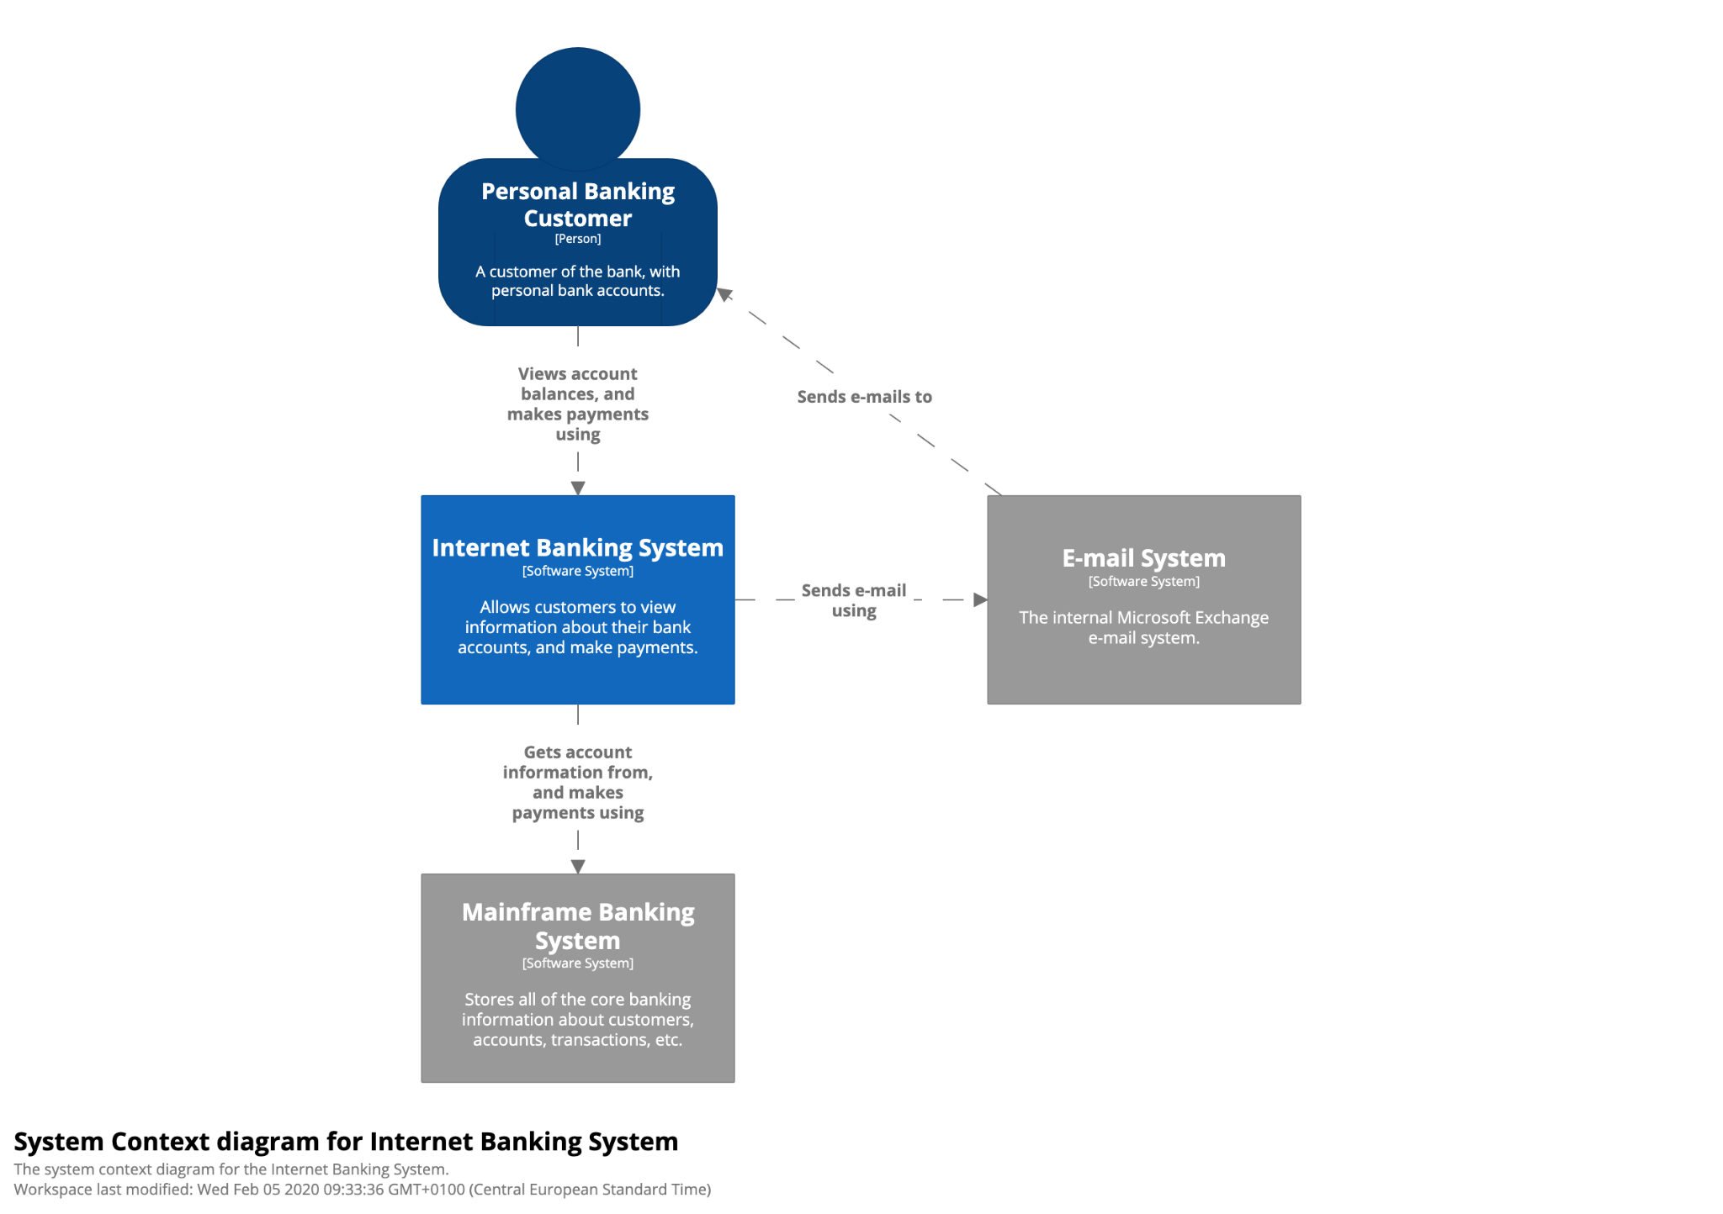
Level 1 - Context
What is it for?
Overview of system purpose
What problem does this solve?
Describe who uses this
Show role of external systems
How is it used?
Leadership - understand purpose for funding / priority decisions
New staff - Understand the context they are working in
Architects - Identify system dependencies
Notes:
Executive level summary of what is being built, what other major things it interacts with.
The thing that is present here, that is rarely present in other architecture diagrams is the user(s)
the business reason for the system

Slide 22
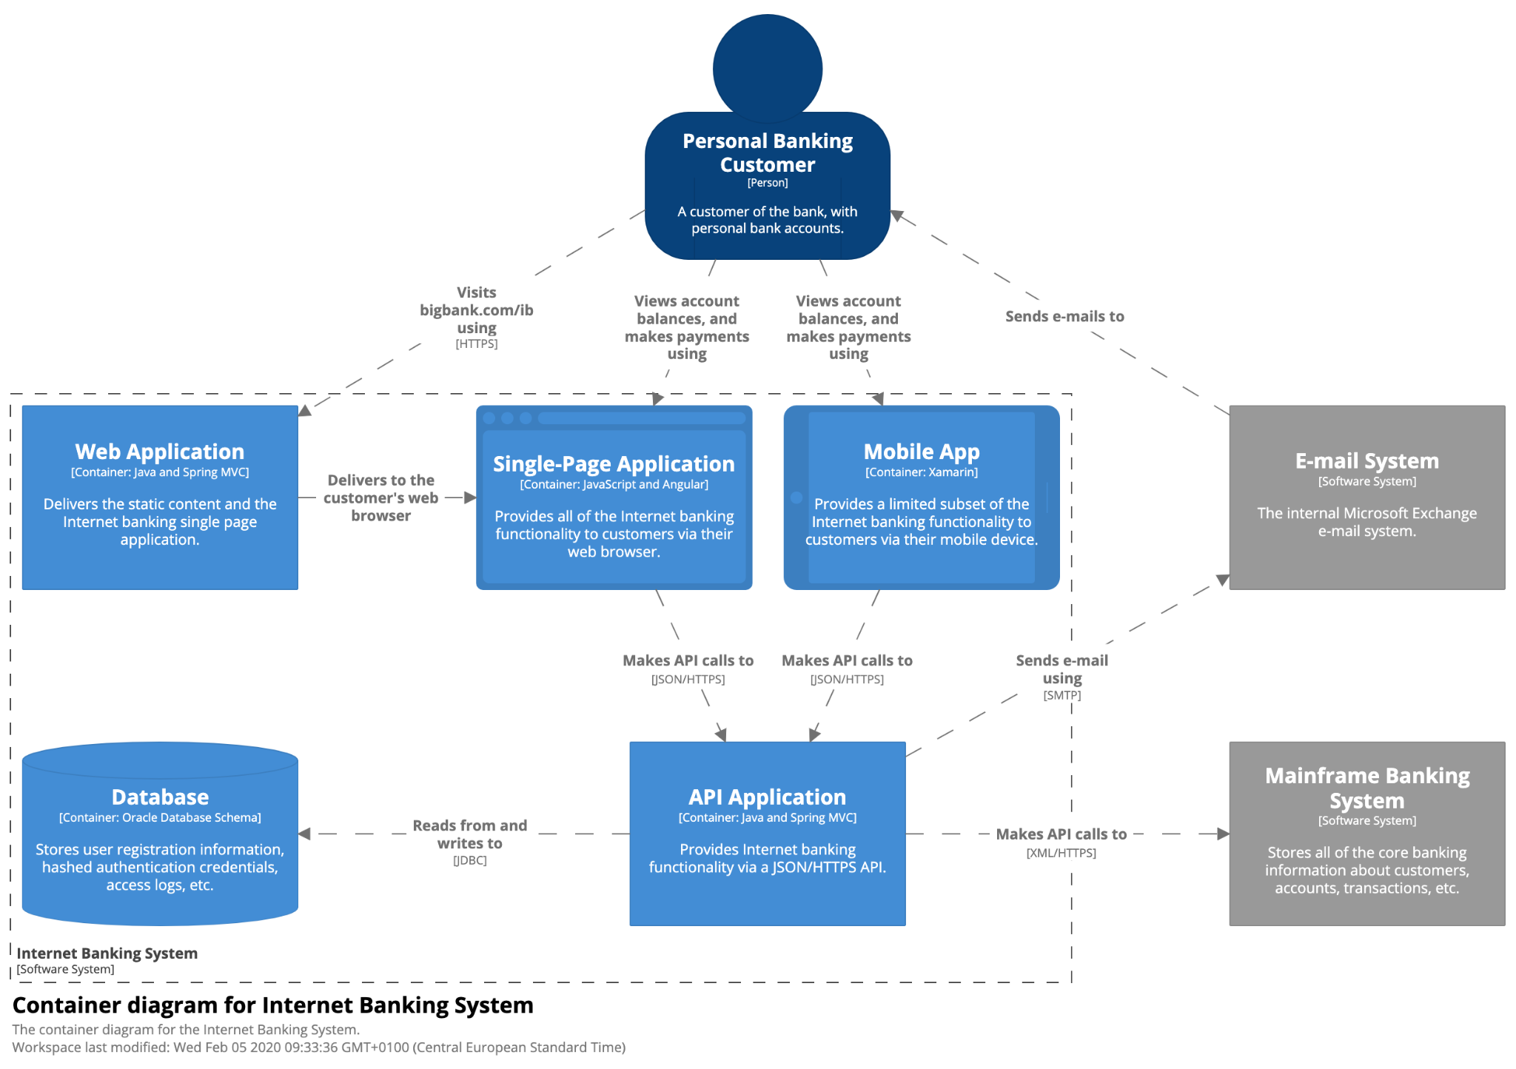
Level 2 - Containers
What is it for?
Identify topology of a system
Show technology choices
Identify communication patterns
How is it used?
System Architects - Plan out system architecture & tech choices
Developers - Understand how components interact
Operations - Plan how to support, identify outage impacts
Notes:
Still useful to a business person
Could be useful to a developer onboarding, or understanding broad scope
Technology choices
Protocols between systems

Slide 23
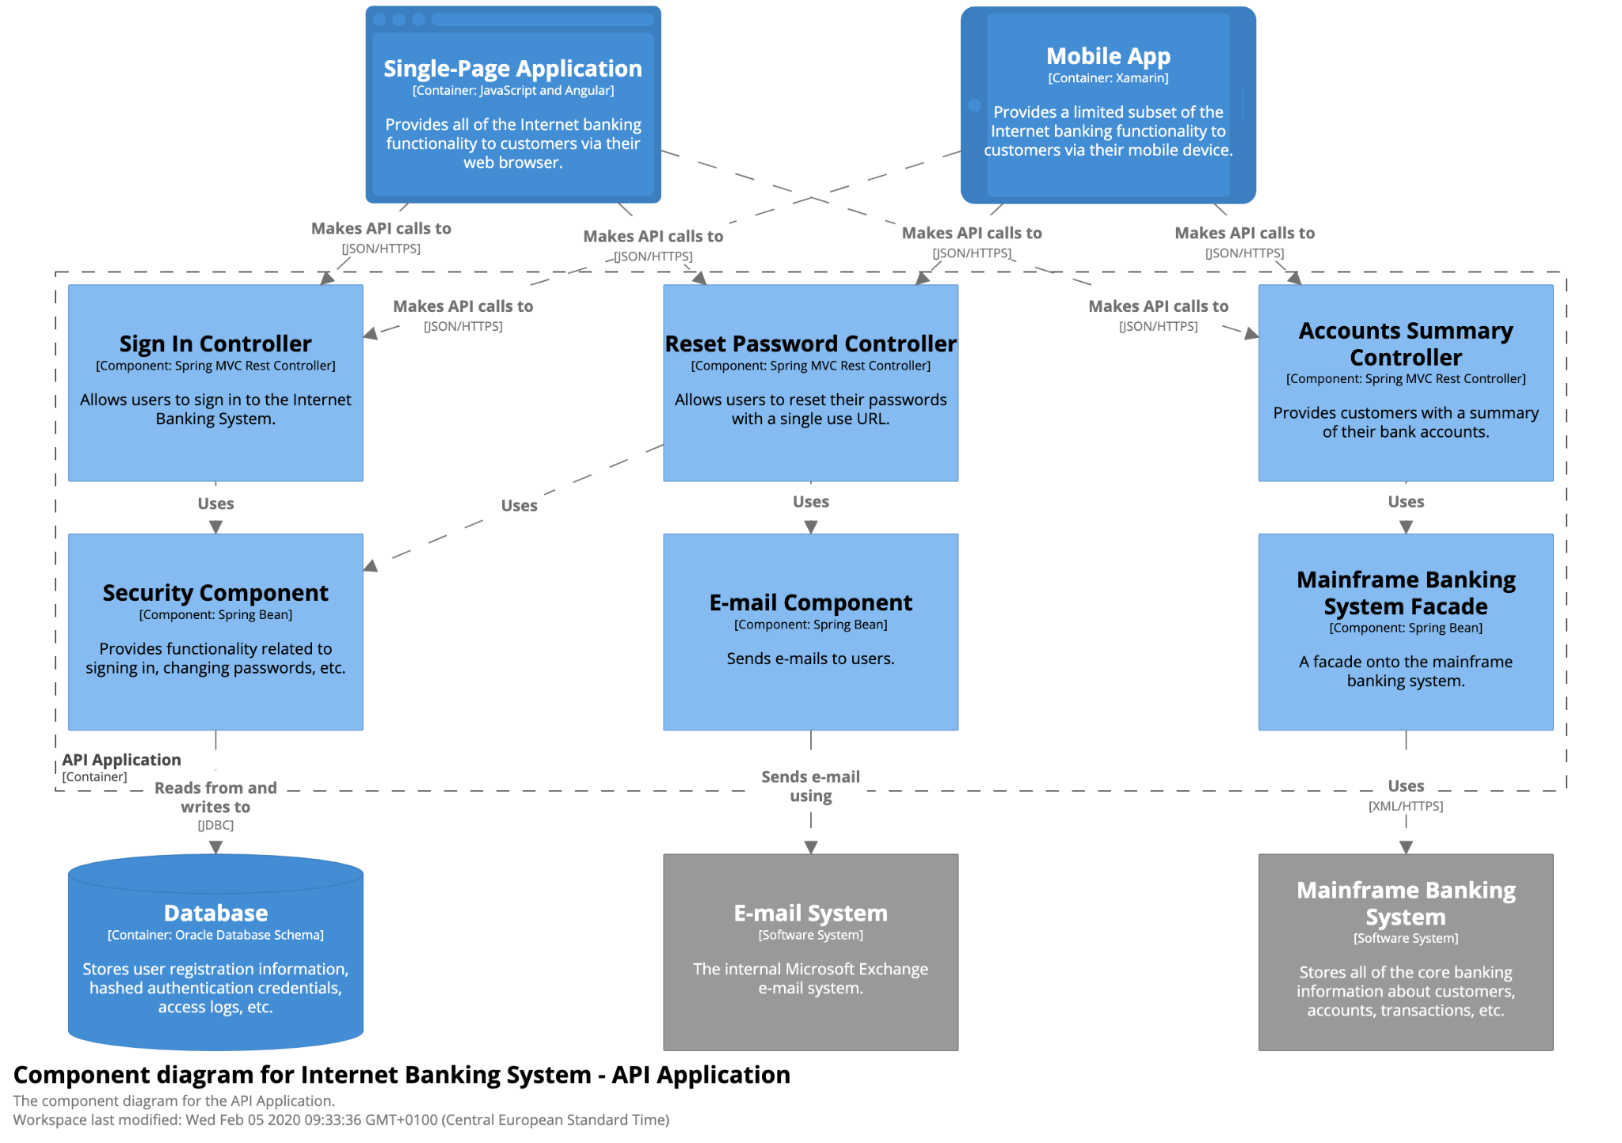
Level 3 - Components
What is it for?
Identify responsibilities and interactions between modules
Show technology choices
How is it used?
Software Architects - Plan out structure. Identify domains
Developers - Understand where changes need to be made

Slide 24
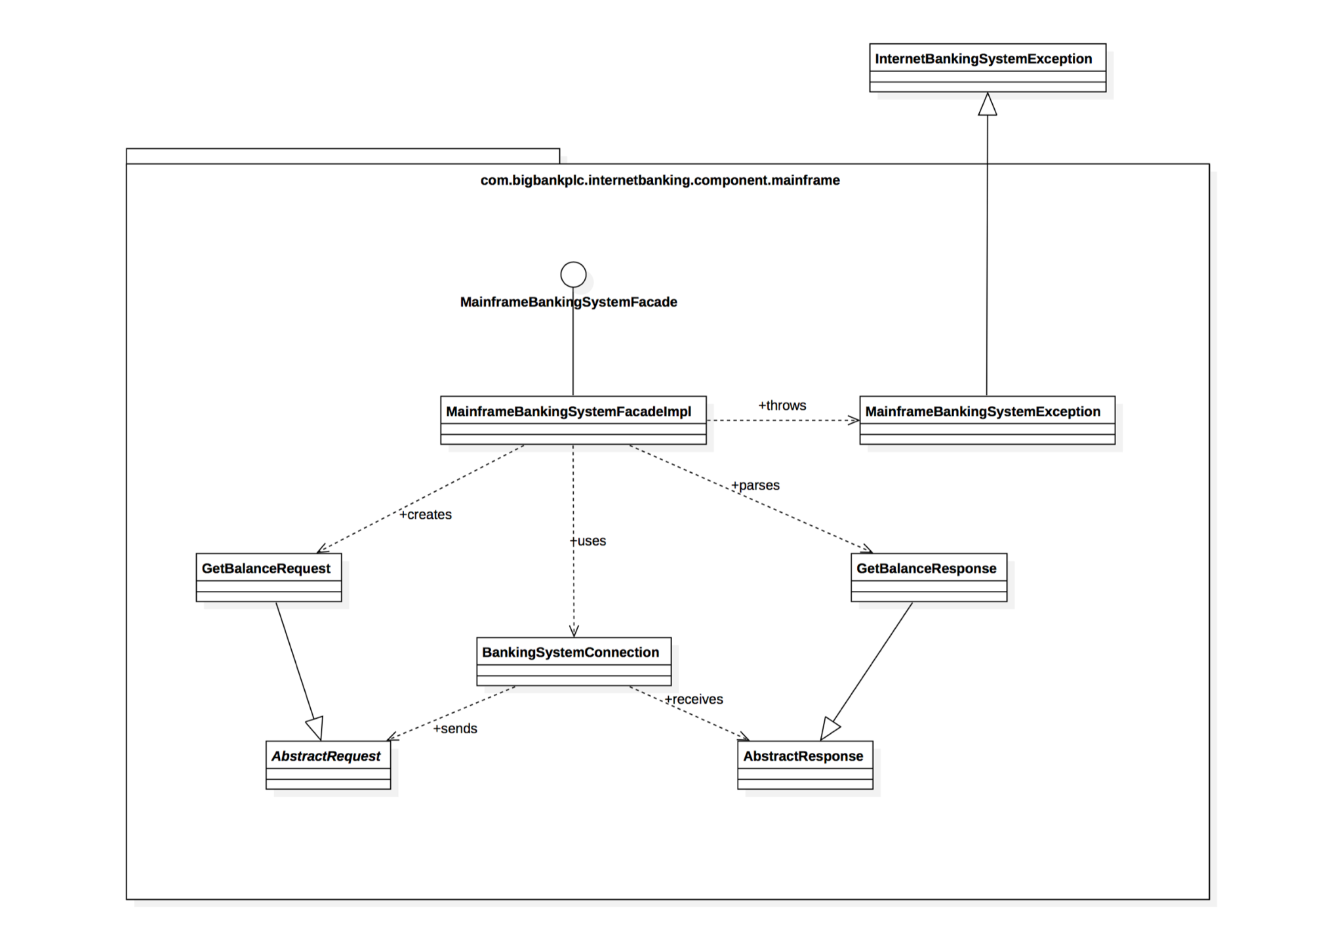
Level 4 - Code
What is it for?
Identify very granular relationships within the code
Use tooling to generate this after the fact in most cases
How is it used?
Software Architects - Plan out mission critical components ahead of time
Developers - Understand class structure, impact of changes
Notes:
Only do this up front for really complex / important parts, or in highly regulated industries
Otherwise, generate from tooling

Slide 25
Supplementary Diagrams in C4
Diagram | Description
System Landscape | 10,000 ft view of all systems in an environment. This would sit above a Context diagram, and would have all of the systems that all of the possible Contexts might have.
Dynamic Diagram | Animatable Sequence Diagrams at a any C4 level. It’s more free-form in its arrangement, and not strictly “swimlanes” like a UML Sequence Diagram
Deployment Diagram | Specify how an architecture is realized in infrastructure across environments. Example: A system may be in a Docker container in a local development environment, in a on-premise K8s pod in Development environment, and running 10 replicas in EKS in production.
Perspectives | Not a separate diagram, but overlays that can be added to Elements to document cross cutting concerns (ie. Security Perspective, PII Compliance Perspective)

Slide 26
A Word on Acronyms and Abbreviations
Notes:
Early in covid, my wife put together grocery list, and I went shopping. She wasn’t going out, because we had a 7 month old.
Milk, Eggs, Toilet paper?, “Chx”

Slide 27

Notes:
This is what she wanted

Slide 28

Notes:
This was what I bought

Slide 29
Limit Abbreviations to Industry Standard Terms

Slide 30
Use Legends for other key indicators

Slide 31
Tools & When to Use Them

Slide 32
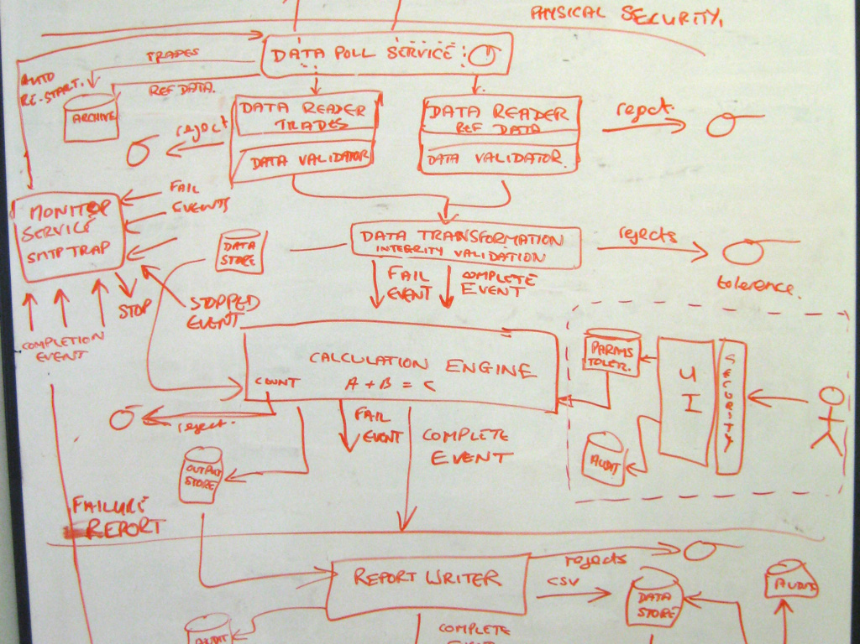
The Whiteboard (Physical or Digital)
When to use it?
Rapidly iterating on ideas in a small group in person or in a call
When NOT to use it?
Basically any other time
Anti-Patterns
Taking a picture with your phone and calling it documentation
Exporting only the image
“SAVE” on the conference room board
Diagram not in source control
Notes:
Whiteboards are great when you use them as intended. They are for creative ideation, not documentation.
Digital might be SketchTogether, Diagrams.net, Miro, etc.

Slide 33

ADR - Architecture Decision Record
When to use it?
Capture important decisions
Capture alternatives considered
Documenting “Why” for the future
When NOT to use it?
Minor decisions
Anti-Patterns
Echo chamber
Not submitting for advice before decision
Notes:
Whiteboards are great when you use them as intended. They are for creative ideation, not documentation.
Digital might be SketchTogether, Diagrams.net, Miro, etc.

Slide 34
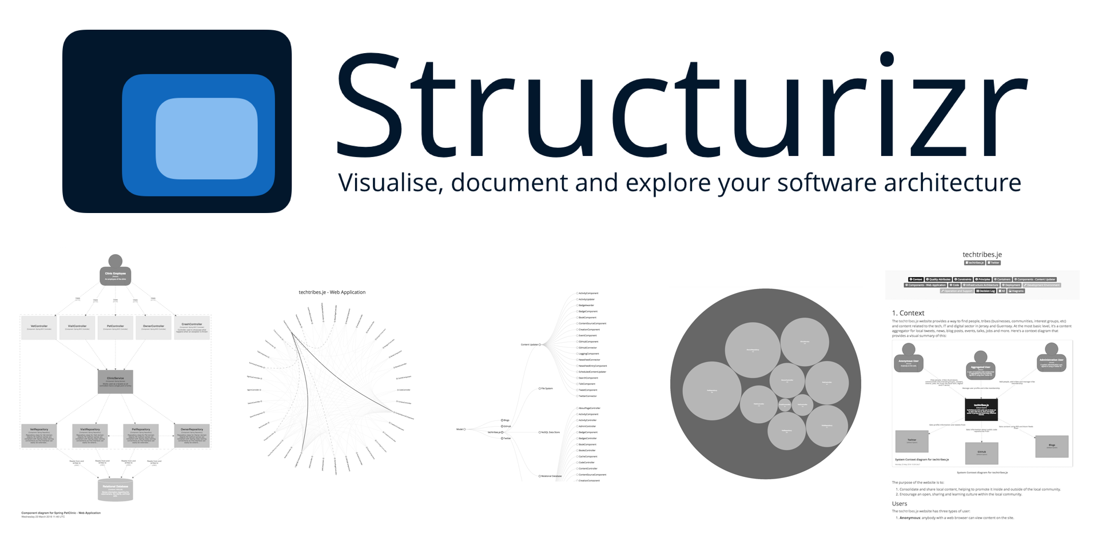
Structurizr
When to use it?
Multiple audiences interested in work
Focus on the system as a whole
In conjunction with ADRs
When NOT to use it?
Small, very simple systems
POC / Spike solutions
Anti-Patterns
Modeling all the way to Class level
Notes:
Structurizr gives a DSL to break down systems in an iterative fashion. Unlike PlantUML where you are trying to describe how to render something, you just describe the system, and Structurizr handles how it should look.

Slide 35
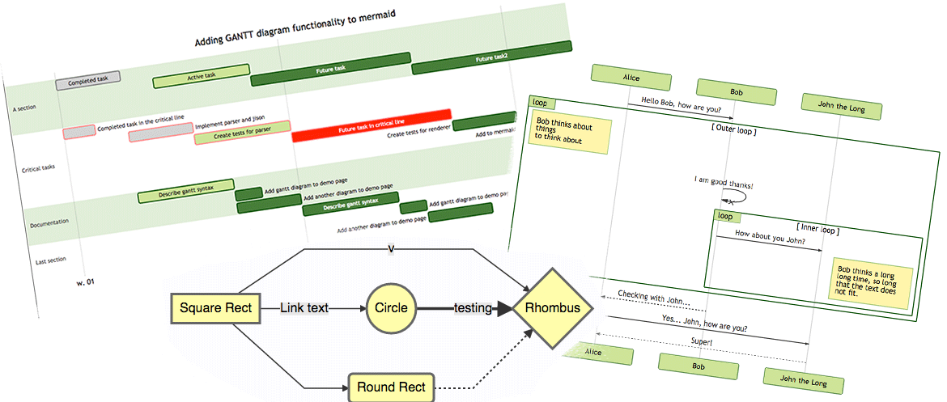
Mermaid Charts
When to use it?
Capture Sequences or Logic Flows
More detail oriented views
When NOT to use it?
Need to build very custom diagrams
“Pretty” counts
Anti-Patterns
Treating Sequence Diagrams and Flowcharts as architecture
Notes:
Whiteboards are great when you use them as intended. They are for creative ideation, not documentation.
Digital might be SketchTogether, Diagrams.net, Miro, etc.

Slide 36
“Why not Visio / Enterprise Architect / <insert tool here>?”

Slide 37
ADRs, Structurizr, and Mermaid all “live” close to the code
Notes:
I can use simple editors like VS Code (or Vim if you’ve figured out how to exit)
Follow same development processes
More efficient, I don’t need to spend time doing layout.

Slide 38
So what does this look like?
Notes:
Show Repository

Slide 39
Tying it all together

Slide 40
Architecting w/ C4 & Diagrams as Code
01
Audience Mismatch
Diagrams scoped from high to low levels
Drill down far enough for each audience
Connect lower level requirements to business case
02
Expensive Tools that Don’t Help
Use VS Code or any text editor
Opinionated starting place
Simple notation to avoid confusion
03
Out of sync documentation
Lives in Source Control with Code
Reference outputs in Markdown files
04
Process
Common framework to think through architecture
Consistent across projects and clients
Familiar process and tooling for developers
Notes:
Go through points
How does this make remote work easier?
Good documentation is a form of async communication
Rely on Github and standard development flows.
Automate processes via Github Actions
Easily leverage Pairing tools (Code with Me, LiveShare) to collaborate.

Slide 41
Questions?

